Slide 1
ICTCS 2020
Thermal Image Processing and Analysis for Surveillance UAVs
Paper ID: 415

Slide 2



Team Composition
AASISH TAMMANA | PES University, RR Campus, Bengaluru
AMOGH MP | PES University, RR Campus, Bengaluru
GAGAN B | PES University, RR Campus, Bengaluru
Paper Id: 415

Slide 3
Paper Guides
Dr. Anuradha M Chairperson Department of ECE Faculty of Engineering B.Tech PES University | Prof. H R Vanamala Associate Professor Department of ECE Faculty of Engineering B.Tech PES University
Paper Id: 415

Slide 4
Contents
Introduction
Problem Statement
Paper Hypothesis
Literature Survey
Dataset
Methodology
Fire detection
YOLOv2
HOG
Final drone assembly
Results
Comparison between YOLOv2 and HOG
Conclusion
Future works
References
Paper Id: 415

Slide 5
Introduction
People trapped by fire/smoke may have as little as six minutes to survive in an environment containing only 15% oxygen. The time is even shorter when you consider excessive heat and poor victim health. Scouting a place on fire is one of the most important and dangerous aspects of a firefighter’s job.
It is clear that time and accuracy to spot victims are of the key to the success of a firefighter’s job.
Paper Id: 415

Slide 6
Problem statement
Saving time in searching for victims in an open area of fire while reducing the risk of firefighters getting caught in the fire themselves.
Processing and enhancing thermal videos for surveillance UAVs.
Paper Id: 415

Slide 7
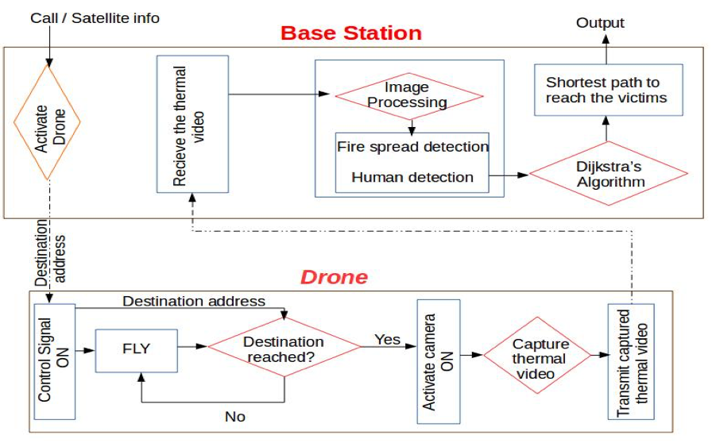
Paper Hypothesis
Thermal video processing has not been explored to a great extent in the field of Surveillance. We aim at exploring and implementing it. The below flowchart gives a representation of how the entire process would look like:
Our proposed paper focuses on Thermal Video Processing part of the paper hypothesis, since it is a crucial component in surveillance.
Paper Id: 415

Slide 8
Literature Survey - HOG
Histogram of Oriented Gradients, also known as HOG, is a feature descriptor that extracts only the useful information (features) from an image, calculates gradients and generates a histogram of those gradients. [1]
Feature Descriptor [2]
Gradients
Generating Histogram of Oriented Gradients
Preprocessing
Calculation of the gradients
Calculation of histogram
Block Normalization [3]
Calculation of feature vector
Paper Id: 415

Slide 9
Literature Survey - YOLO
You Only Look Once, also known as YOLO, is an algorithm for object detection which locates and classifies certain objects/humans present in an image. [4]
In this algorithm, an image is taken as input and split into a grid size of N × N. It further predicts k bounding boxes inside each of the grid created. Each grid is modelled to predict only one object. The bounding box outputs class probabilities for all the classes and five other parameters which consists of offset values: centre coordinates, height, width of the resulting bounding box and the objectness score. The objectness score is the probability of the object to be present in the bounding box. [5][6]
YOLOv2
Batch normalization
YOLOv2 architecture [7]
Basic image preprocessing
Extraction of Region of Interest (ROI)
Probability evaluation
Paper Id: 415

Slide 10
Dataset
A thermal video of fire was shot during a massive forest fire in Oakland, California in 2018.
The ‘OTCBVS Benchmark Dataset Collection’ was used to obtain thermal images for human detection.
This benchmark dataset is publicly available.
The benchmark dataset comprises of images and videos recorded in the visible and infrared spectrum.
In 2004, this was started by Dr. Riad I. Hammoud at Ohio State University. Dr. Guoliang Fan at Oklahoma State University is presently managing it.
Dataset 01 and Dataset 05 were used for implementation and testing from the OTCBVS Benchmark Dataset Collection.
Paper Id: 415

Slide 11
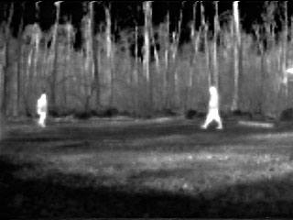
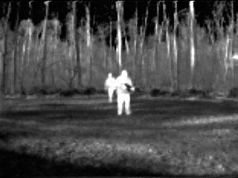
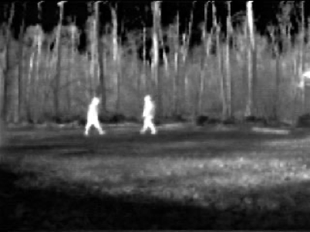
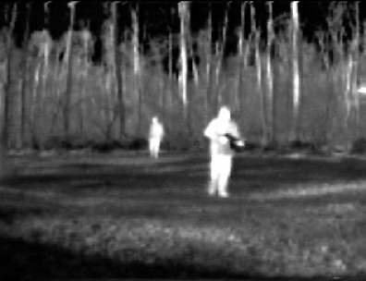
Dataset Images
Paper Id: 415

Slide 12
Methodology
Fire Detection for a thermal video
Human Detection using You Only Look Once(YOLO)
Human Detection using Histogram of Oriented Gradients(HOG)
Paper Id: 415

Slide 13
Fire detection from a thermal video:
Thermal image Processing is used in Quality Control ,Problem Diagnostics, Research and Development, Engineering Design and Development. Features and attributes which cannot be portrayed by a normal camera are well observed with the help of a Thermal camera.
To achieve fire detection, we have used OpenCV and the concept of thresholding with Gaussian Blur.
To assist the firefighters, the Alameda County sheriff’s deputies brought a DJI Inspire 1 drone in to get footage of the fire. The drone is equipped with a thermal camera shows exactly where the hotspots are.
We have used this source as input to test our code.
Paper Id: 415

Slide 14
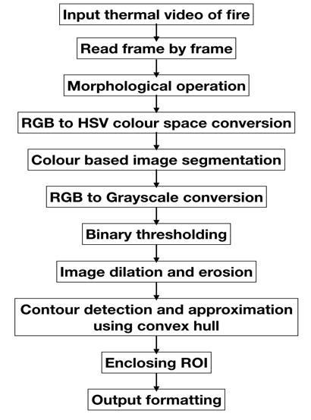
Steps involved in Fire detection
Acquire image frame from the video.
Perform Morphological operation such as Gaussian Blur/ Median Filter Blur.
RGB to HSV colour space conversion.
Colour based image segmentation using Upper and Lower threshold limits.
RGB to Grayscale conversion.
Binary Thresholding on the converted image.
Image dilation and erosion.
Contour detection And approximation using Convex Hull.
Enclosing ROI
Output formatting
Paper Id: 415
Notes:
Steps in title

Slide 15
Human Detection using YOLO algorithm:
YOLO (You only Look Once) is a real-time object detection algorithm.
The YOLOv2 uses a single neural network to the full image. This network divides the image into regions and predicts bounding boxes and probabilities for each region.
Initially, the images are gathered to train. Further, these images are annotated/labelled manually using VOTT.
Using these annotations, we train the algorithm for thermal dataset.
Post training, we test the algorithm and finally input various datasets for detection.
Paper Id: 415

Slide 16
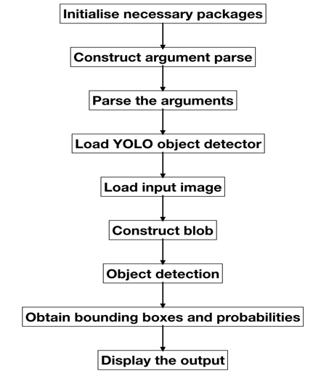
Steps involved in YOLO human detection
Initialize necessary packages.
Construct argument parse and parse the arguments.
Load YOLO object detector and train it with the dataset.
Load input image.
Construct a blob from the input image and then perform a forward pass of the YOLO object detector to give bounding boxes and probabilities.
Loop over each of the layer outputs.
Show the output image.
Exit
Paper Id: 415

Slide 17
Human Detection using HOG algorithm:
The histogram of oriented gradients (HOG) is a feature descriptor used in computer vision and image processing for the purpose of object detection.
The image is split into small regions, further each region is split into smaller parts, a histogram of gradient directions is compiled. The descriptor is the concatenation of these histograms.
The obtained dataset is annotated manually and saved to the disk.
These annotations are used for training and further testing to detect human subjects in a thermal dataset.
Paper Id: 415

Slide 18
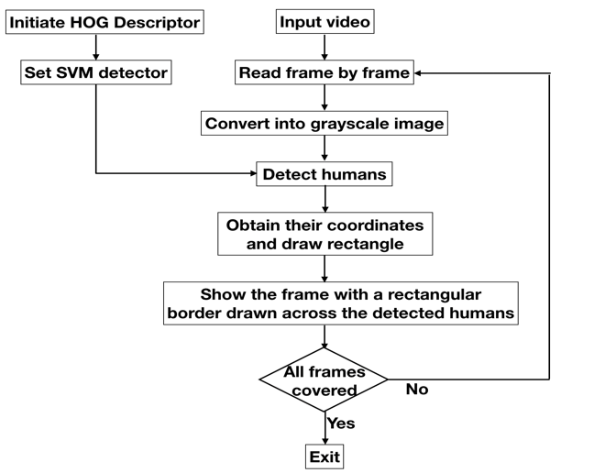
Steps involved in HOG human detection
Instantiate HOG Descriptor
Set SVM Detector to get default people detector
Load input video
Read a frame
Convert it into grayscale image as HOG needs a grayscale image
Detect humans and obtain respective coordinates
Draw rectangle
Show the frame with a rectangle border drawn across the detected human
If end of video is not yet reached, goto step 4
Exit
Paper Id: 415

Slide 19
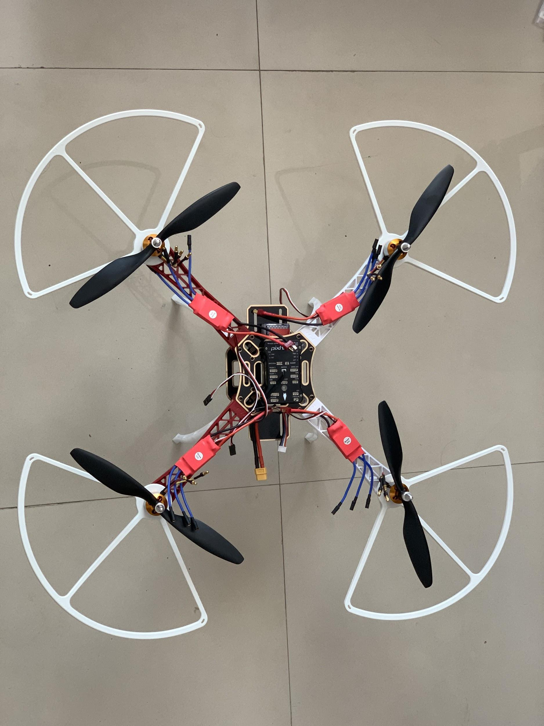
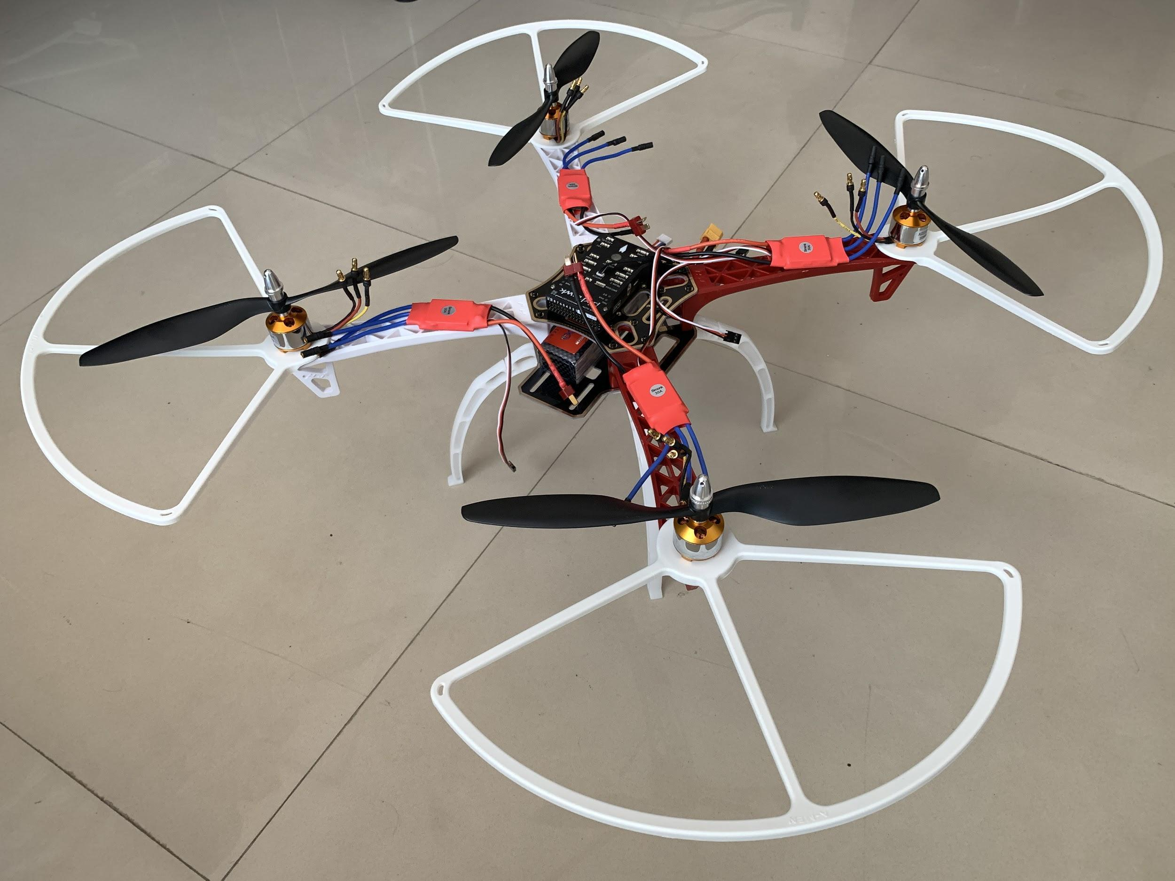
Final Drone assembly
Controlling the drone, as a beginner, was not an easy task. Due to which, one of the four ESCs was damaged during the take off itself. The damaged ESC was replaced but the motors weren’t in sync and the drone wasn’t taking off. After trying out all the possibilities, it was discovered that the replaced ESC do not have the same properties as the other three ESCs. As a result, a new set of four ESCs had to be replaced which were all in sync.
Paper Id: 415

Slide 20
RESULTS
Fire Detection
You Only Look Once(YOLO)
Histogram of Oriented Gradients(HOG)
Comparison between YOLOv2 and HOG
Paper Id: 415

Slide 21
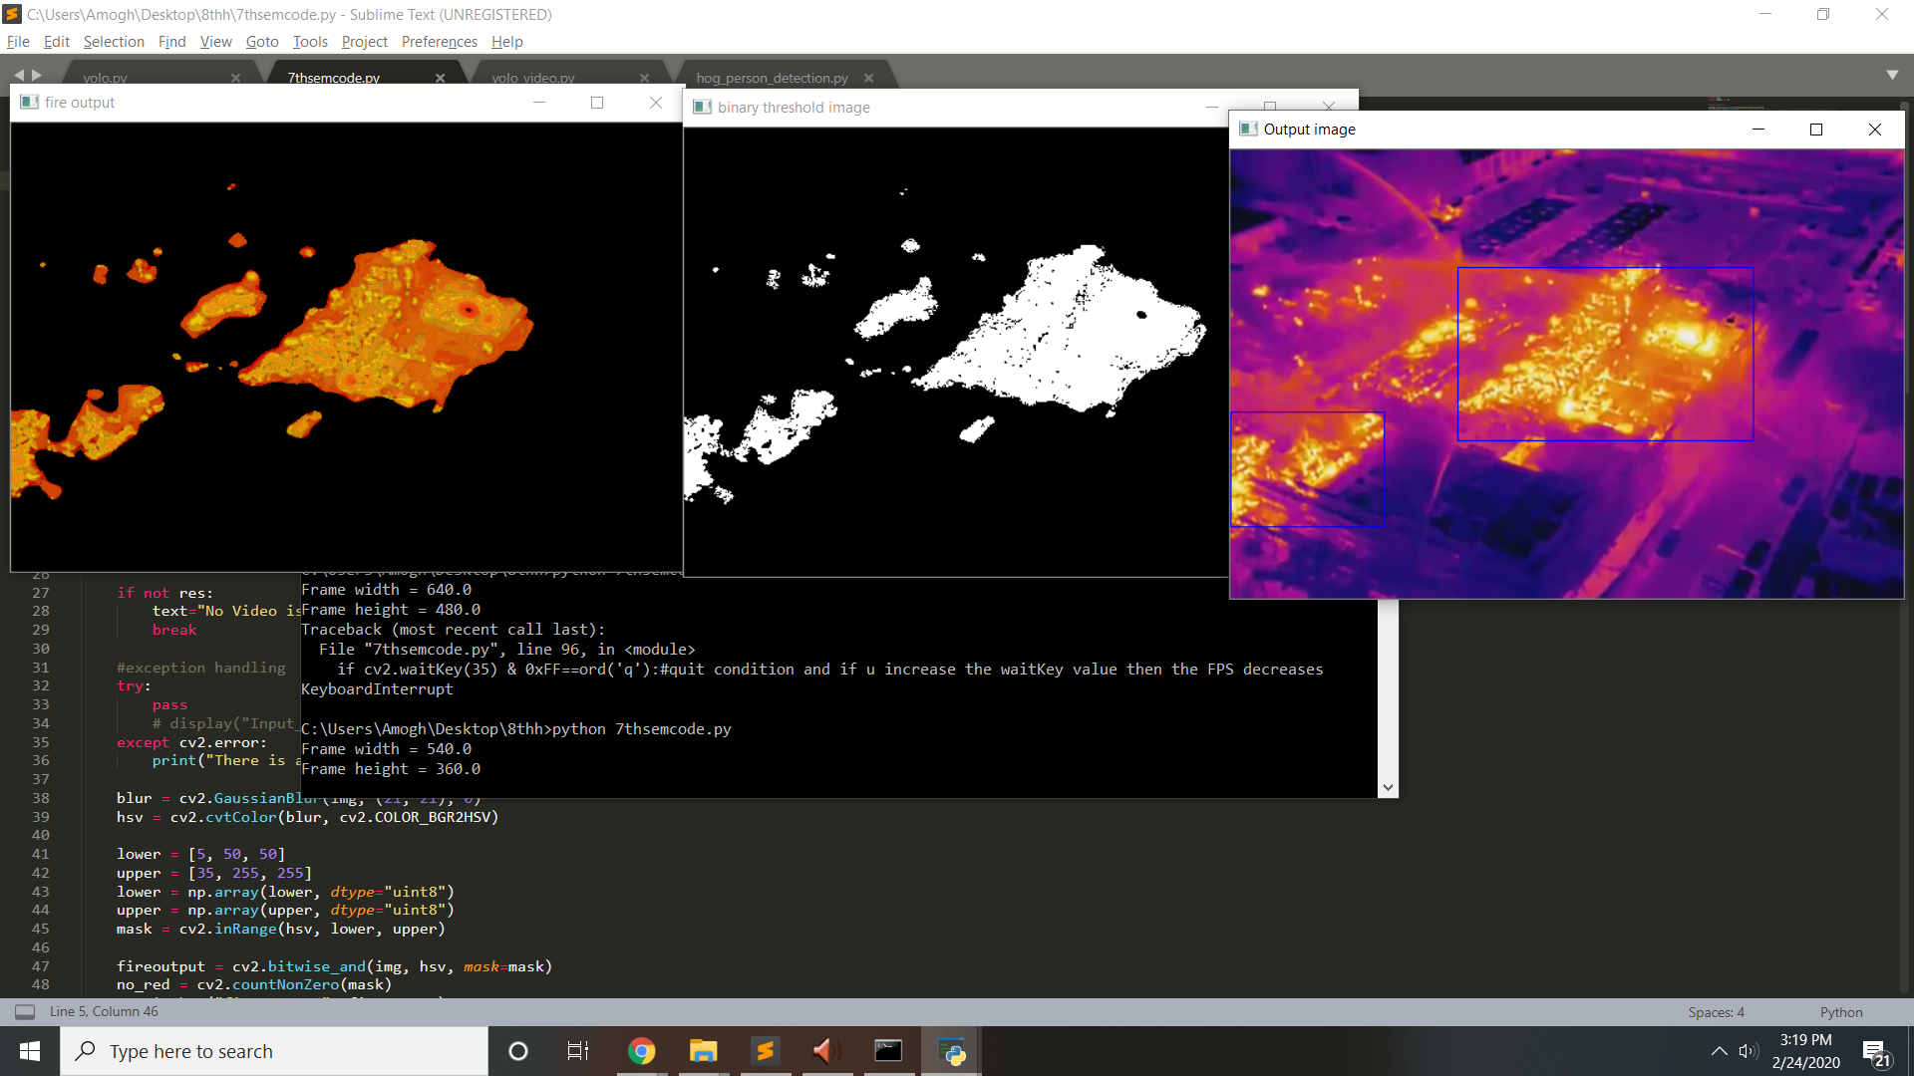
Fire Detection
Input Thermal Video of a region on fire
Result of the executed fire detection algorithm
Paper Id: 415

Slide 22
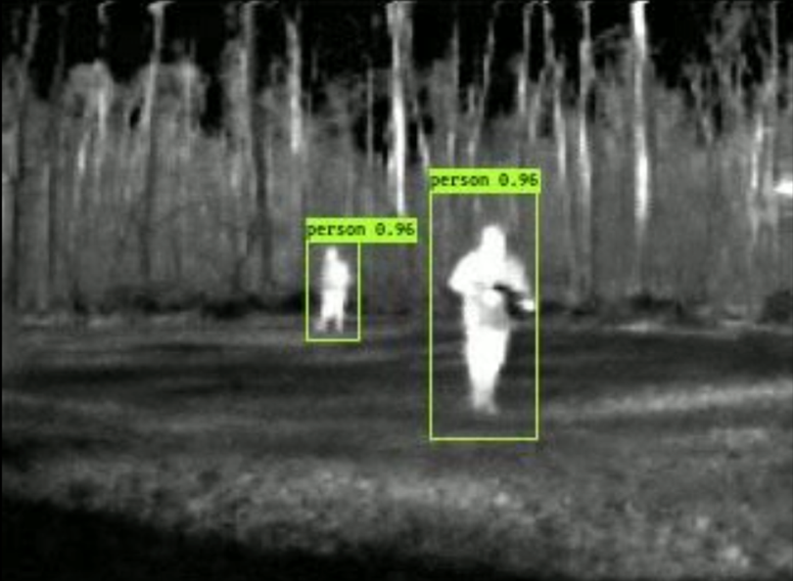
YOLO Output
Human detection in a thermal video using YOLO:
The figure shows that both the human subjects are detected and enclosed in a bounding box along with the probability of detection displayed.
Paper Id: 415

Slide 23
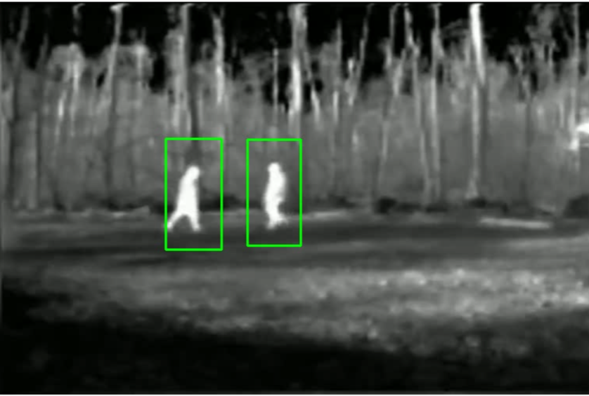
HOG Output
Human detection in a thermal video using HOG:
The figure shows that both the human subjects are detected and enclosed in a bounding box.
Paper Id: 415

Slide 24
Comparison between YOLOv2 and HOG
The YOLOv2 and HOG have both proven to be efficient human/object detection algorithms. These algorithms though, haven't been implemented on thermal videos yet. The next few slides shows the contrast between both algorithms with respect to thermal videos. To choose the base algorithm for thermal video processing of our prototype, a comparison was done between the HOG and YOLOv2 algorithms with respect to their speed and accuracy.
The number of subjects in thea frame decides the performance of both the algorithms. With the increase in number of subjects, the performance reduces for both algorithms.
If there are no objects present/detected in the video, then the more frames are output in a second whereas with the increasing number in the objects detected, the output decreases.
From our observations, when a thermal video with 2 objects(i.e. humans) are input to both YOLO and HOG, the number of frames per second output by the HOG implementation was higher compared to the YOLOv2 implementation. One of the reasons for it is that the YOLO methodology computation is expensive and requires a faster processing unit to get more frames per second output.
Paper Id: 415

Slide 25
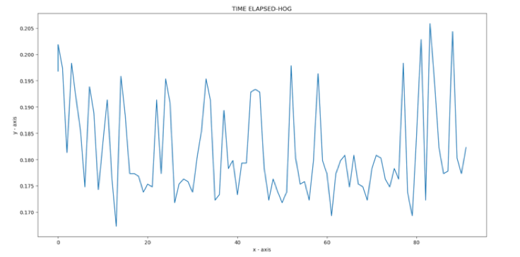
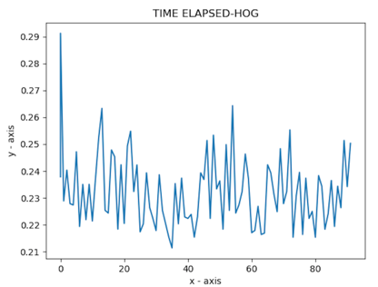
Elapsed time per frame for HOG
The elapsed time per frame for HOG is displayed. The average time per frame taken to execute is 0.1814 seconds. The below graphs are a plot of Elapsed time per frame versus the number of frames in HOG implementation.
Elapsed time per frame for HOG from Processor I7
Elapsed time per frame for HOG from Processor I5
Paper Id: 415

Slide 26
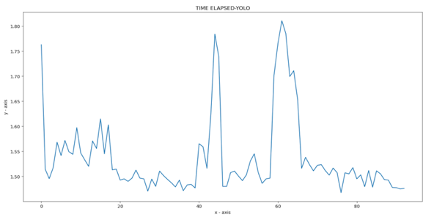
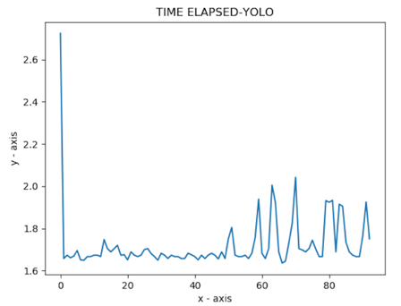
Elapsed time per frame for YOLO
The elapsed time per frame for YOLOv2 is displayed. The average time per frame taken to execute is 1.5539 seconds. The below graphs are a plot of Elapsed time per frame versus the number of frames in YOLO implementation.
Elapsed time per frame for YOLO from Processor I7
Elapsed time per frame for YOLO from Processor I5
Paper Id: 415

Slide 27
Comparison between YOLOv2 and HOG
 | Accuracy
 | YOLO | HOG
Scene 1 | 92.01% | 88.2%
Scene 2 | 73.12% | 72.35%
 | Speed
 | YOLO | HOG
Scene 1 | 2.67 s | 0.18 s
Scene 2 | 2.84 s | 0.26 s
Paper Id: 415
Notes:
Compare with paper and validate

Slide 28
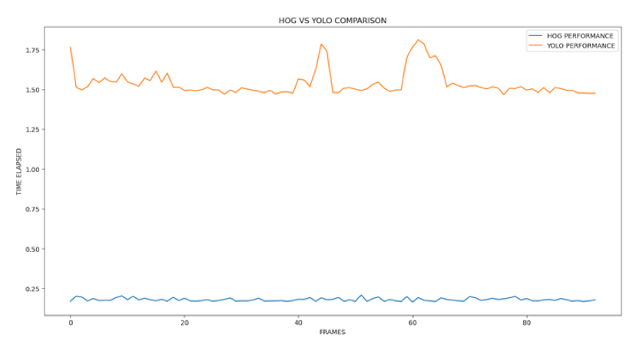
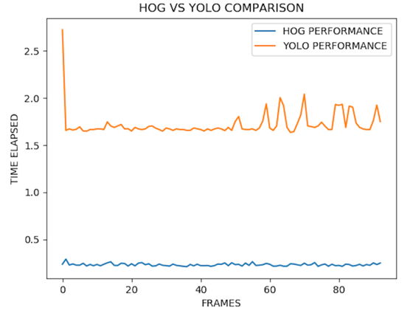
Comparison between YOLOv2 and HOG
The below graph clearly shows that HOG implementation has lower elapsed time per frame than that of YOLO. This concludes that YOLO implementation is faster than that of YOLOv2.
Elapsed time per frame for HOG and YOLO from Processor I7
Elapsed time per frame for HOG and YOLO from Processor I5
Paper Id: 415
Notes:
Switch slides with next one

Slide 29
Comparison between YOLOv2 and HOG
Comparison is done based on two parameters:
Speed:
From the previous slides, we can observe that HOG implementation is faster than YOLOv2
Accuracy:
As seen in the results, although YOLOv2 has a better detection rate, HOG isn’t far behind in terms of detecting human subjects.
Paper Id: 415

Slide 30
Conclusion
A fire detection algorithm was developed for thermal videos which was successful in detecting hotspots and separating them from the regions which are in the safe zone.
Careful and thorough research and implementation of two of the most efficient human/object algorithms namely YOLOv2 and HOG was performed on thermal datasets.
The HOG algorithm proved to be significantly faster for thermal videos than the YOLOv2 but the detection rate for YOLOv2 was superior to that of HOG.
This brought us to the conclusion that the HOG algorithm would be suitable for thermal video processing in our surveillance UAV since time is crucial and the detection rate is above par.
Paper Id: 415

Slide 31
Future Works
Our focus in the future will be to improve our model's performance on images and videos that do not contain the entire body of the person and in cases where only one profile of a person is visible, for example, presence of only the top view or side view of a person.
We would like to experiment with more recent person localization models like YOLOv3 and other skeletal models. Different tracking algorithms will be researched in an attempt to achieve better accuracy.
Designing a drone which is capable of resisting some amount of fire so that close surveillance is possible. Also, achieving maximum speed of the drone and making it autonomous is also an important feature which would highly benefit the paper.
The drone can be equipped with possible fire extinguisher mechanism.
Paper Id: 415

Slide 32
References
1. N. Dalal and B. Triggs, "Histograms of oriented gradients for human detection," 2005 IEEE Computer Society Conference on Computer Vision and Pattern Recognition (CVPR'05), San Diego, CA, USA, 2005, pp. 886-893 vol. 1.
2. N. Nguyen, D. Bui and X. Tran, "A Novel Hardware Architecture for Human Detection using HOG-SVM Co-Optimization," 2019 IEEE Asia Pacific Conference on Circuits and Systems (APCCAS), Bangkok, Thailand, 2019, pp. 33-36.
3. S. Ioffe and C. Szegedy. Batch normalization: Accelerating deep network training by reducing internal covariate shift.arXiv preprint arXiv:1502.03167, 2015
4. Joseph Redmon, Santosh Divvala, Ross Girshick, Ali Farhadi; “You Only Look Once: Unified, Real-Time Object Detection”,The IEEE Conference on Computer Vision and Pattern Recognition (CVPR), 2016, pp. 779-788
5. C. Li, Y. Li, S. Wang and X. Zhang, "Moving Human Body Detection in Video Sequences," 2007 International Conference on Machine Learning and Cybernetics, Hong Kong, 2007, pp. 2188-2192.
6. Redmon, Joseph, and Ali Farhadi. "YOLO9000: better, faster, stronger." arXiv preprint (2017).
7. W. Lan, J. Dang, Y. Wang and S. Wang, "Pedestrian Detection Based on YOLO Network Model," 2018 IEEE International Conference on Mechatronics and Automation (ICMA), Changchun, 2018, pp. 1547-1551.
8. C. Zhao and B. Chen, "Real-Time Pedestrian Detection Based on Improved YOLO Model," 2019 11th International Conference on Intelligent Human-Machine Systems and Cybernetics (IHMSC), Hangzhou, China, 2019, pp. 25-28.
9. G. Ding, Q. Wu, L. Zhang, Y. Lin, T. A. Tsiftsis and Y. Yao, "An Amateur Drone Surveillance System Based on the Cognitive Internet of Things," in IEEE Communications Magazine, vol. 56, no. 1, pp. 29-35, Jan. 2018.
Paper Id: 415

Slide 33
References
10. Ambuj Kumar, Bilal Muhammad, "On how internet of drones is going to revolutionise the technology application and business paradigms", Wireless Personal Multimedia Communications (WPMC) 2018 21st International Symposium on, pp. 405-410, 2018.
11. L. Meier, P. Tanskanen, F. Fraundorfer and M. Pollefeys, "PIXHAWK: A system for autonomous flight using onboard computer vision," 2011 IEEE International Conference on Robotics and Automation, Shanghai, 2011, pp. 2992-2997.
12. L. Feng and Q. Fangchao, "Research on the Hardware Structure Characteristics and EKF Filtering Algorithm of the Autopilot PIXHAWK," 2016 Sixth International Conference on Instrumentation & Measurement, Computer, Communication and Control (IMCCC), Harbin, 2016, pp. 228-231.
13. K. Mizuno, Y. Terachi, K. Takagi, S. Izumi, H. Kawaguchi and M. Yoshimoto, "Architectural Study of HOG Feature Extraction Processor for Real-Time Object Detection," 2012 IEEE Workshop on Signal Processing Systems, Quebec City, QC, 2012, pp. 197-202.
14. L. Weixing, S. Haijun, P. Feng, G. Qi and Q. Bin, "A fast pedestrian detection via modified HOG feature," 2015 34th Chinese Control Conference (CCC), Hangzhou, 2015, pp. 3870-3873.
15. S. Kim and K. Cho, "Trade-off between accuracy and speed for pedestrian detection using HOG feature," 2013 IEEE Third International Conference on Consumer Electronics ¿ Berlin (ICCE-Berlin), Berlin, 2013, pp. 207-209.
16. P. Tumas, A. Jonkus and A. Serackis, "Acceleration of HOG based pedestrian detection in FIR camera video stream," 2018 Open Conference of Electrical, Electronic and Information Sciences (eStream), Vilnius, 2018, pp. 1-4
17. K. Jo, J. Im, J. Kim and D. Kim, "A real-time multi-class multi-object tracker using YOLOv2," 2017 IEEE International Conference on Signal and Image Processing Applications (ICSIPA), Kuching, 2017, pp. 507-511.
Paper Id: 415

Slide 34
References
https://steadyhawk.com/the-blog/dronemapping Drone mapping
https://gilscvblog.com/2014/05/15/an-easy-and-practical-guide-to-3d-reconstruction/
https://blog.dronedeploy.com/4-steps-for-making-an-excellent-3d-model-with-a-drone-25dc35f1df62 Deploying a drone
https://opencv-python-tutroals.readthedocs.io/en/latest/py_tutorials/py_setup/py_setup_in_windows/py_setup_in_windows.html OpenCV installation
https://sourceforge.net/projects/numpy/files/NumPy/1.7.1/numpy-1.7.1-win32-superpack-python2.7.exe/download Numpy installation
http://vcipl-okstate.org/pbvs/bench/ - OTCBVS Benchmark Dataset Collection
https://www.pyimagesearch.com/2015/03/30/accessing-the-raspberry-pi-camera-with-opencv-and-python/ - Interfacing the camera to the Pi and getting a live stream.
http://vcipl-okstate.org/pbvs/bench/Data/03/download.html - Dataset of thermal images
https://www.dslrpros.com/firefighting-drones.html Gaetting to know more on firefighting drones
Paper Id: 415

Slide 35
THANK YOU
Paper ID: 415

